Slide 2
Aim of the Session
Red Cross/ Red Crescent Movement architecture for managing operations:
Legal, the Emergency Response Framework, Surge Tools and Operational Structure.
(90 minutes)
This session explores the cooperation roles and interactions among the different components of the RC/ RC Movement in relation to emergency operations, with a particular focus on the legal foundations, Emergency Response Framework, disaster response mechanisms, surge capacity tools and operational structure.

Slide 3

Learning Objectives 1/2
At the end of the session, participants will be able to:
Mention the main legal instruments that form the RC/ RC’s foundations for disaster response.
Understand the purpose and rationale of the IFRC Emergency Response Framework.
Identify the different categories of disasters defined in the Response Framework along with the roles and responsibilities of the different RC/ RC stakeholders.

Slide 4
Learning Objectives 2/2
At the end of the session, participants will be able to:
List the various RC/ RC disaster response mechanisms, surge capacity tools and support services available and identify their main roles and responsibilities in a specific disaster situation in a local region.
Recognize the complementary cooperation and coordination among the components of the RC/ RC Movement and its disaster response mechanisms, surge capacity tools and support services in a specific disaster situation.
Position the Ops Manager within the RC/ RC architecture for disaster response operations.

Slide 5
Session Contents
This session will include:
The main RC/ RC legal foundations for emergency response operations.
The purpose, rationale and key elements of the Emergency Response Framework.
The IFRC response architecture: Surge mechanisms and tools (RDRT, NDRT, ERU, FACT, etc.).
The IFRC operational structure and reporting lines (at the global, regional and national levels) and how Ops Managers fit into the picture.

Slide 6
I.
RC/ RC
LEGAL
FRAMEWORK
WHO
WE ARE

Slide 7
Overview of the RCRC legal framework
STATUTES
International Conference
CONSTITUTION
IFRC General Assembly
IFRC POLICY INSTRUMENTS
P&R
STRATEGY INSTRUMENTS
IFRC Secretariat and/or
individual
IFRC members
OPERATIONAL INSTRUMENTS/GUIDANCE
The P&R document has been adopted by all NSs in a General Assembly.

Slide 8




The umbrella:
Existing international law and agreements
Existing agreements between States or States and assisting actors
International humanitarian, human rights and refugee law
International law related to privileges and immunities
The statutes and regulations of the International Red Cross and Red Crescent Movement and existing legal arrangements between the Movement’s individual components and States.
Source: Introduction to the Guidelines for the Domestic Facilitation and Regulation of International Disaster Relief and Initial Recovery Assistance, IFRC, 2011.

Slide 9

The Seville Agreement
Title: Agreement on the Organisation of the International Activities of the Components of the International Red Cross and Red Crescent Movement
Signed: 26th November 1997
Updated: Resolution 8 : Implementation of the Seville Agreement, 2005
Notes:
.

Slide 10
II.
IFRC
EMERGENCY RESPONSE FRAMEWORK
WHO
WE ARE

Slide 11
What is the IFRC Emergency Response Framework?
This Emergency Response Framework describes clear roles and responsibilities across all levels of the IFRC secretariat, to support timely, predictable and accountable emergency response decision making.
Approved by SG, 2nd June 2017

Slide 12
Main content of the Response Framework
A. Principles underpinning the Framework
B. IFRC approach to operational response
    Accountability
    Human Resources
    Lessons learning and knowledge management
C. Operational Response Framework
    Key roles and Responsibilities
    Disaster Categorisation
    Taskforce Model
    Emergency Funding
Annexes:
RACI table
Emergency Task Force Model
Table of detailed roles and Responsibilities
Draft SoPs
Disaster and Crisis Categorisation

Slide 13
The IFRC Emergency Response Framework…
Provide an articulated framework, to deliver faster, more streamlined, and empowered decision making in emergency response situations.
Support a level of consistency and coherence across the working modalities, capacities and resources of Geneva and the Regional Offices (ROs) to address the current culture of competition and duplication.
Underpin an increased commitment to accountability for operational decision making and service delivery.

Slide 14
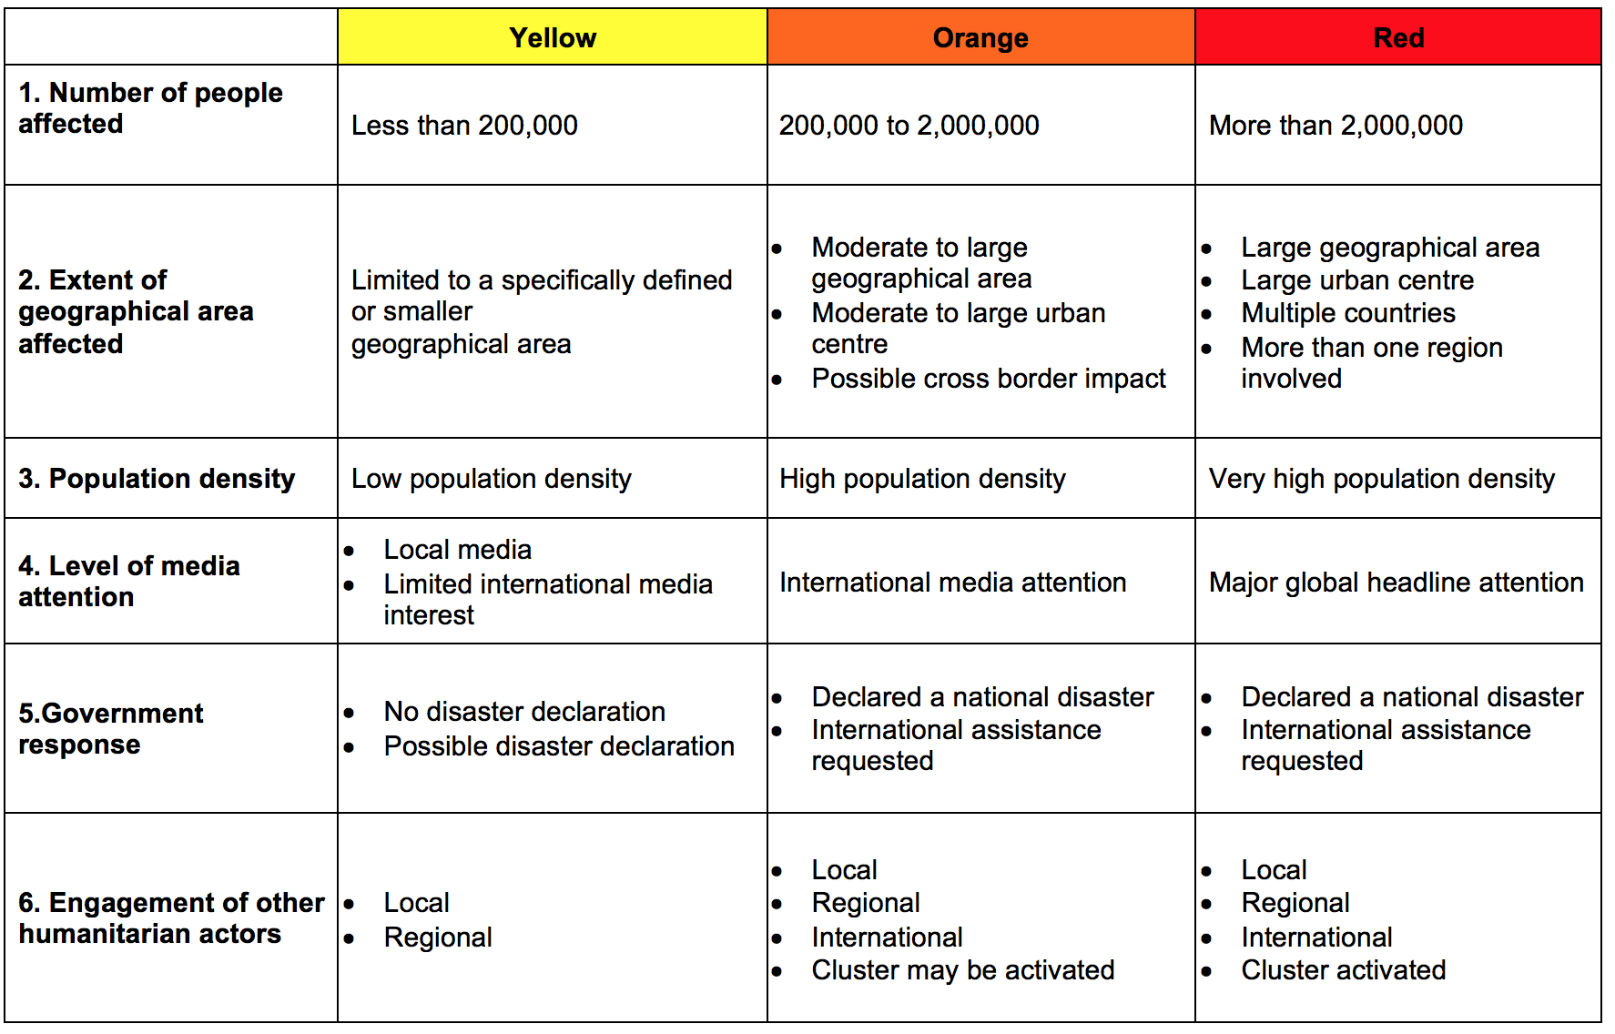
IFRC criteria to determine the disaster category

Slide 15
RCRC Response Factors
1.No. of targeted population | Less than 50,000 | 50,000 to 500, 000 | More than 500,000
2. Financial resources required | DREF International Appeal < 3 million CHF | DREF of 250,000 – 500,000 International Appeal between 3-20 million CHF | DREF of >500,000 International Appeal >20 million CHF
3. Level of PNS involvement | In country PNS engaged | ~5 to ~10 international PNS engaged | >10 international PNS engaged
4. Involvement of surge capacity | IFRC Secretariat support from the Country, Region or Zone (e.g. RDRTs), with limited Global DR tools | IFRC Secretariat support with requirement for Regional, Zonal and Global surge capacity including HEOps, or FACT | The full Global DR system is deployed (DREF, EA, RDRT, HEOps, FACT. ERUs)

Slide 16
The IFRC decentralised structures

Slide 17
Overall Roles and Responsibilities… (by levels)
NSs are the lead actors in preparing for and responding to emergencies. Country offices or country cluster support teams (CO/CCST) take the primary role in supporting the NS. The Head of the CO/CCST is responsible for the overall delivery of the appropriate support to the NS.
Regional Offices accountable for the direction and quality of emergency response operations within their region, take the lead in setting and maintaining the overall strategic direction, and ensures that the needed support is in place.
Geneva secretariat provide overarching strategic direction to ensure global coherence, compliance with global policies / standards and to provide technical expertise or advice and surge capacity or funds (DREF) as required.

Slide 18
Roles & Responsibilities: Emergency Response Framework
OPERATIONAL RESPONSE FRAMEWORK | CO/CCO | RO | GVA
DURING AN EMERGENCY
On-going support to NS to deliver operational response (as per conting. plan) | R | A | C/I
Coordination of in-country IFRC resources and assets | R/A | C | I
Setting and guiding operational strategy for emergency response | R | R/A | C
Identifying needs and priorities for support | R/A | R | C
Emergency Appeals - preparing and implementing | R | R/A | C
Continuous quality assurance to ensure best practice response | I | R/A | C
Ensuring compliance with global standards and best practice | C/I | R | R/A
Accessing DREF | C | R | R/A
Preparing and launching an EA | R | R/A | C
Deploying regional surge capacity (RDRT) | C | R/A | I
Deploying and coordinating global surge capacity (FACT, ERU, HEOps) | C | R | A
Mobilise Emergency Shelter Cluster resources as necessary | C | C | R/A
Mobilising financial resources | R/I | R/A | R/I
Notes:
R: Responsability
A: accountability
C: consultation
I: Information

Slide 19
Roles & Responsibilities: Response Framework
OPERATIONAL RESPONSE FRAMEWORK | CO/CCO | RO | GVA
Providing data analysis and IM support | C | R | A
Manage logistics services | R | A | C/I
Posting reports and operations updates for partners | R | R/A | I
Writing and disseminating communications (media, key messages etc.) | R | R/A | R
Set up monitoring systems and provide management reports | R/A | C | I
Set up all financial systems | R | R/A | C
Set up Movement coordination systems | R | R/A | C
Engaging with external and inter-agency co-ordination mechanisms | R | R/A | R
Technical advice / guidance to country office | C | R/A | I
Technical advice / guidance to regional office | I | C/R | R/A
Commissioning and managing Real Time Evaluations (RTEs), | C | C | R/A

Slide 20
Notes:
This slide could be hidden from the presentation as it’s unlikely the task force meeting will be in place by the time Ops Manager comes in. However, as it’s posible that a new emergency happens within an ongoing response, the Ops Manager will have a role in TF meetings

Slide 21
III.
SURGE TOOLS
WHO
WE ARE

Slide 22



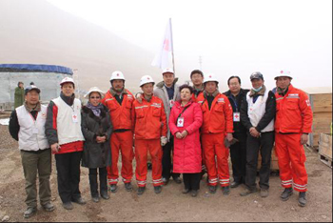
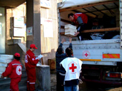


IFRC Global Disaster Response Tools
People
NDRT
RDRT
HEOps
FACT
Equipment
People
ERUs
Funding
DREF
EA
Information Management
DMIS/Go Platform
Notes:
This slide is just to provide a quick refresher of the main tolos existing ar rge momment. It is important to mention that the whole surge system is currently under revision and changes as part of the “Surger Optimazation” process, which is expected to be implemented over a period of three years, 2017-2020.

Slide 23
IV.
OPERATIONAL
STRUCTURE &
REPORTING
LINES
WHO
WE ARE

Slide 24
Emergency Phase: Reporting lines (additional official communication lines)
HEOps
HNS
PNS HQ
FACT
RDRT
IFRC
Geneva
IFRC Country / Regional
DMU
RDRT
Tech
coord
Tech
coord
ERU
ERU
ERU
RDRT
RDRT
RDRT

Slide 25
Head of CCO/CO
Way 1
Ops. Coord./ H. DCPRR- RO
Ops Manager
Way 2
Ops. Coord./ H. DCPRR- RO
Head of CCO/CO
Ops Manager
Ops. Coord. CCO
Way 3
H. DCPRR- RO
Ops Manager
Notes:
Ops Manager need to find out during their briefing under which reporting line model they will be working, as it can change every time. Here some of the most common ways. Doted line represents “technical line”

Slide 26
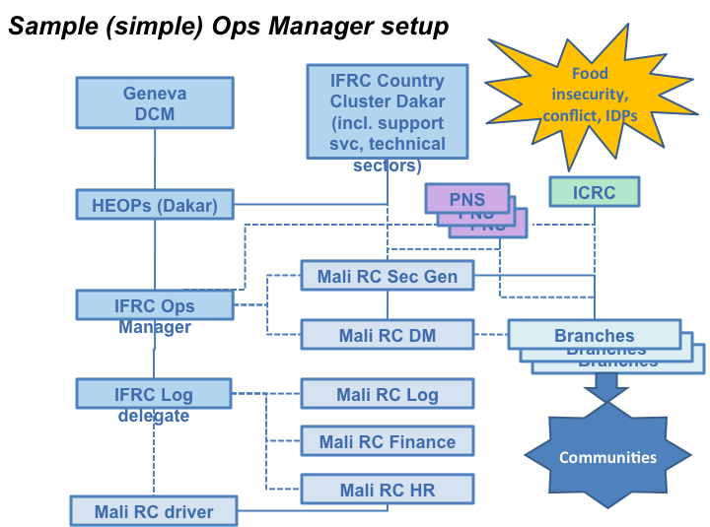
Sample (simple) Ops Management Setup
DM Coord. (Dakar)

Slide 27

KEY MESSAGES (recap)
To prevent and mitigate the humanitarian consequences of a disaster in a pertinent, holistic, efficient and sustainable manner, the RC/ RC Movement has a global, integral and multilevel humanitarian system, composed of disaster response mechanisms, surge capacity tools and support services.
The action and cooperation among the components of the RC/ RC Movement (and between them and external actors) during an international disaster response operation are governed by globally consistent mandatory documents, policies, strategies, rules, standards, tools and procedures.
All the RC/ RC Movement components involved in an international disaster response operation have a specific role and responsibilities.
The Host National Society is the axis of the disaster response operation.
The IFRC members, IFRC and the ICRC contribute to this humanitarian system with human, material and financial resources.

Slide 28

REFERENCE DOCUMENTS AND KEY READING
IFRC Emergency Response Framework, June 2017
A short guide to ERUs
ERU SOPs
FACT Business Process, 2014
IFRC – Emergency Response Policy, 1997
IFRC – Integrating Relief Rehabilitation and Development Policy
IFRC – Post-emergency Rehabilitation Policy, 1999
SIMS fact sheet

Slide 29

THANK
YOU
Working together, we can save
more lives and build stronger,
more resilient communities.

