Slide 1






IFRC Surge Tools
 | Support with strategic leadership during large scale disaster & crisis Three-member roster ready to deploy in 48 hours
 | Support with assessment, planning and coordination Deploy as multisectorial team
 | Bridge a gap in services when local facilities are overwhelmed. People and equipment to support with Health, WASH, IT-Tel, Logistics, Relief, and Basecamp services
 | Remote support with the collection, collation, analysis and dissemination of information to aid decision making in emergencies.

Slide 2
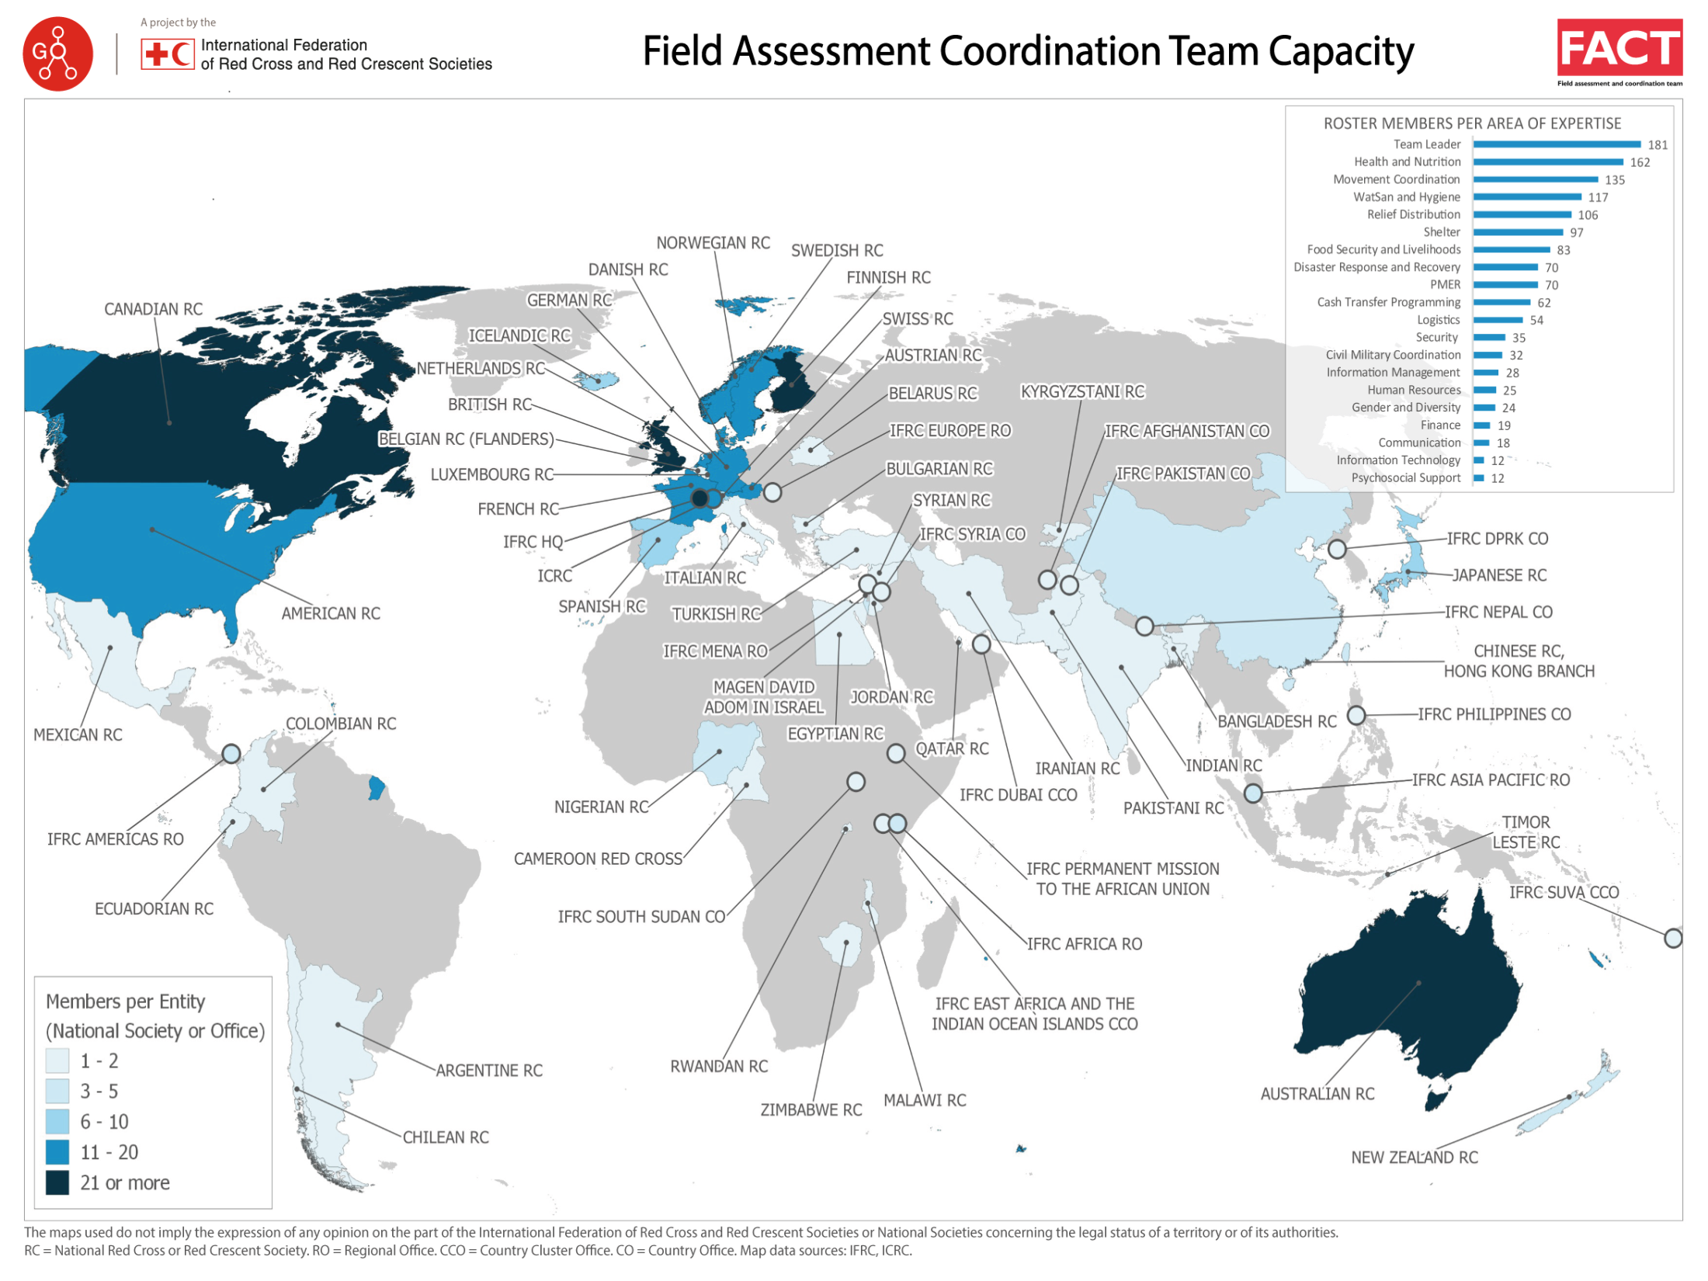

Slide 3
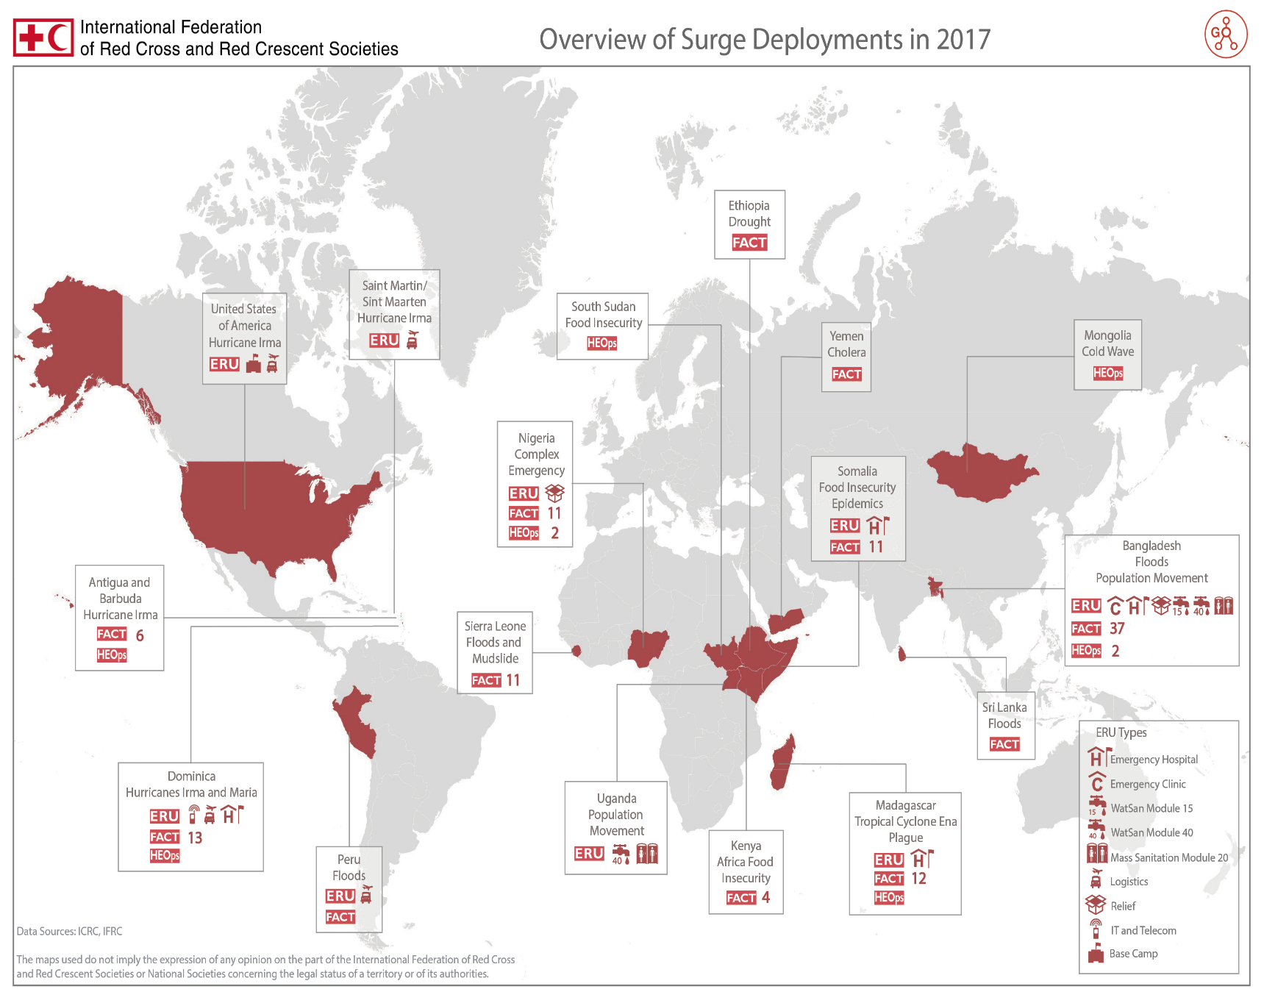




8
109
members
17
172
members

Slide 4
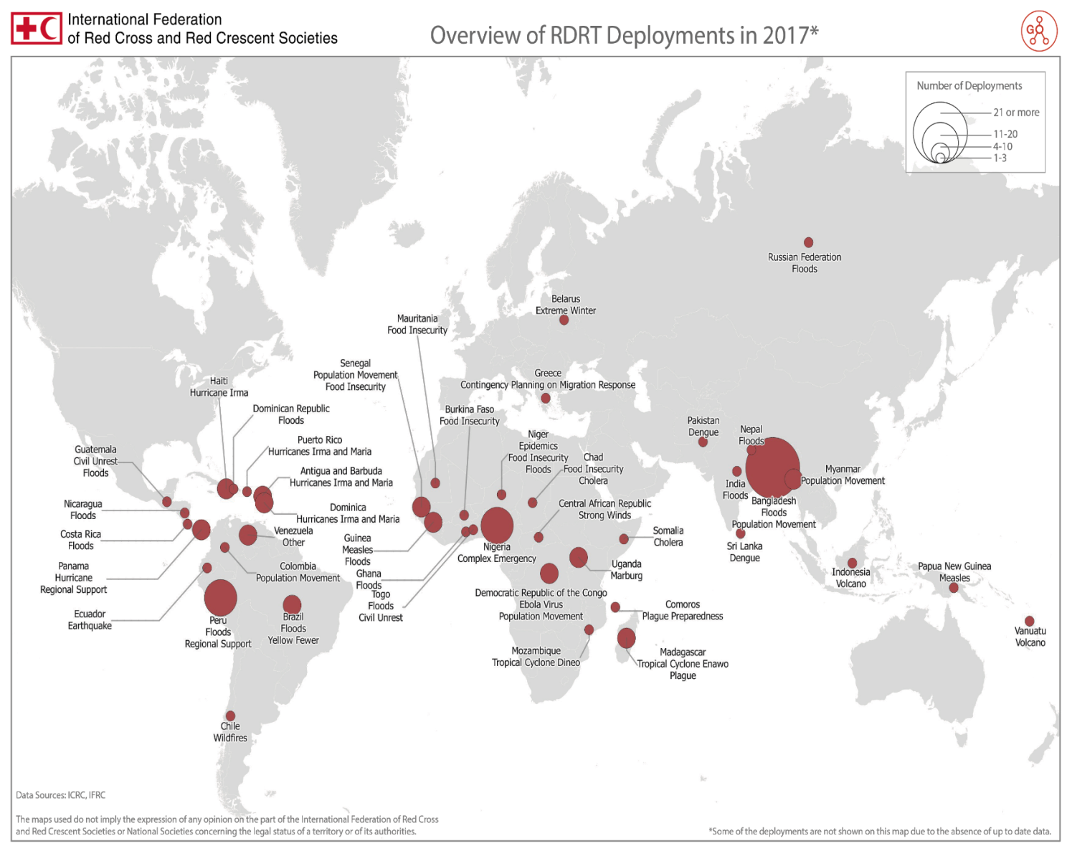
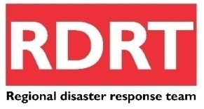
172
Deployments
in 2017

Slide 5
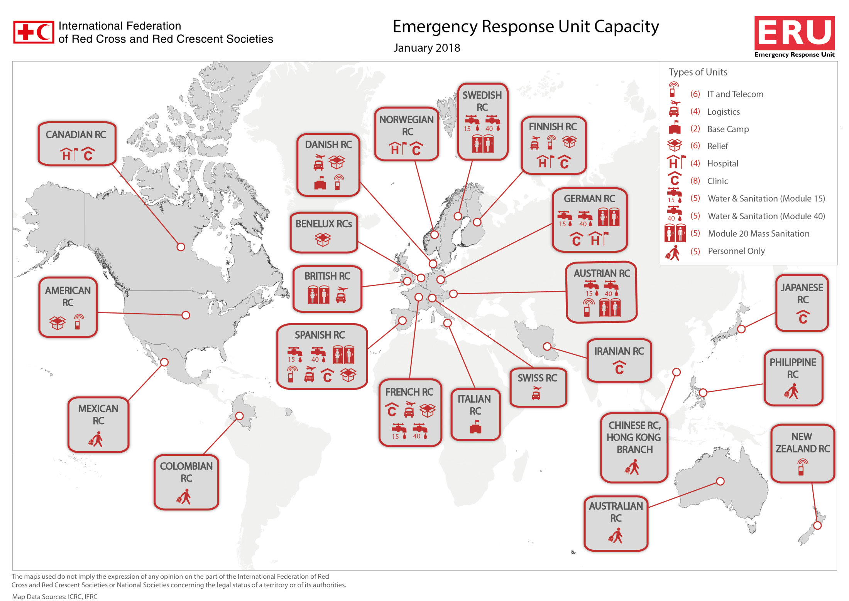

Slide 6
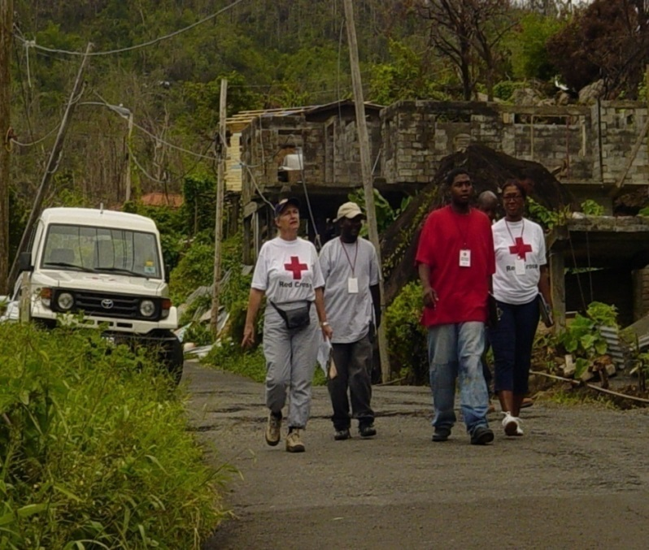
RDRT
RDRT Induction Course
Regional Response Teams (RDRT)
Often speak the local language
Understands the local culture
Can be deployed for smaller
scale emergencies
They are integrated into the operation depending on their competencies
Notes:
What are the advantages of the NDRT and the RDRT?
Designed for fast delivery, fast set-up and standardisation supports same level of quality and joint deployments

Slide 7
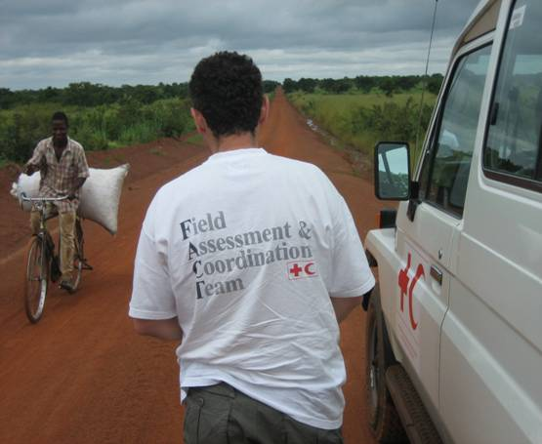
Field Assessment & Coordination Team (FACT)
FACT
Globally selected RC/RC team
Primary outputs:
  Assesses needs
  Plan of Action (PoA)
In country for 2-6 weeks
Deployed within 48 hours
Standardised training
Compatible to UNOCHA’s
  Coordination with UN
Notes:
Rapid international level response tool for the Red Cross / Red Crescent in disaster relief – 47 missions since 2000
Shared ownership by Federation Secretariat and national Red Cross and Red Crescent Societies globally.
367 people from 70 NSs, ICRC and Federation Secretariat with range of skills have followed 2-week FACT training
Support to national Red Cross/Crescent Societies in their auxiliary role in national disaster response
Deployment in 12-24 hours for 2-6 weeks
Compatible with UN/OCHA's UNDAC system
Linkage to regional response mechanisms

Slide 8
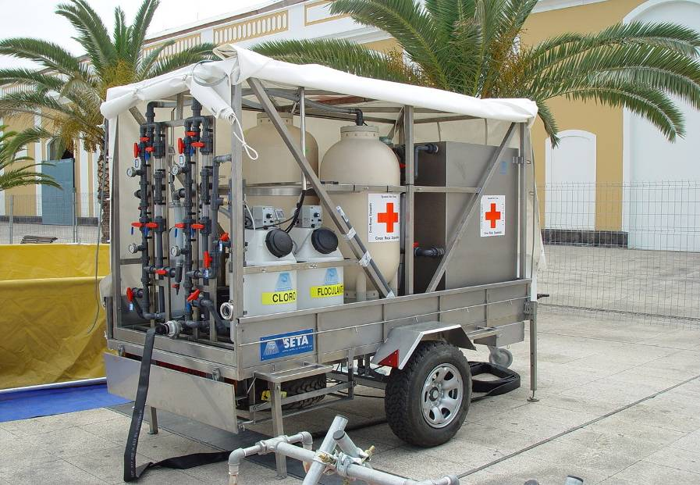
Emergency Response Units (ERU)
ERU
ERUs rapidly provide crucial
services to affected people.
Bridge a gap in services when local facilities are overwhelmed.
Rapid set-up where services are not available.
Notes:
Designed for fast delivery, fast set-up and standardisation supports same level of quality and joint deployments.

Slide 9
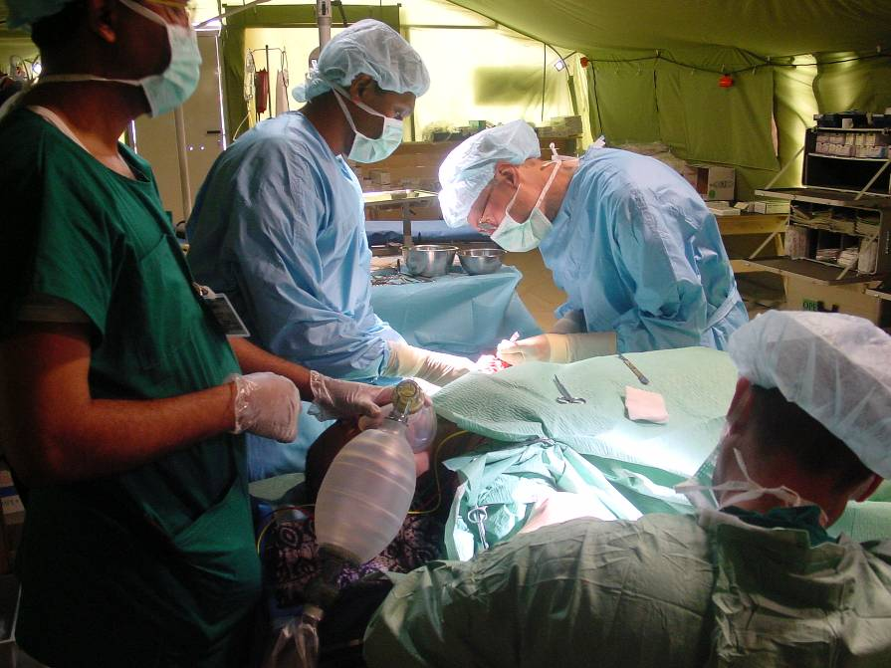
Types of ERUs
ERU
  RC Emergency Hospital
  RC Emergency Clinic
    WASH ERUs:
        Water treatment (M40)
        Specialised water (M15)
        Mass sanitation (MSM20)
    Logistics
    Relief distribution
    IT &Telecommunication
    Base Camp
Notes:
First level referral hospital, providing essential services for a population of up to 250,000 people. The inpatient capacity ranges from 120 - 150 beds, providing surgical and medical care, intensive observation, anesthesia and operating theatre, x-ray, laboratory, maternal-child health, pharmacy, sterilization and outpatients clinics. This ERU works on the basis of an agreement with the health ministry of the country affected, and welcomes national health staff to work alongside the expatriates.
2. Rapid Deployment Hospital
A lighter version, the so-called Rapid Deployment Hospital, can deploy within 48 hours of alert and offers first aid, triage and medivac as well as limited medical/surgical care, including an OPD. A 10 beds capacity is also available. It can function up to 10 days pending assessment and arrival of a more complete hospital or Basic Health Care ERU. Flexible and mobile, requiring no loading equipment, the team works with limited equipment and resources. It can also be used as mobile clinic if required at later phase of operation.
Basic health care
This ERU provides immediate preventive, curative and community health care. It can deliver outpatient clinic service and mother and child health including uncomplicated. Moreover, community outreach, health promotion, epidemic control, surveillance, community-based psychosocial interventions, immunisation and therapeutic feeding can be conducted through optimized modules.
The unit enables the care for a population of 30 thousand people, can care for 20 temporary inpatients, and provides referral services to other secondary and tertiary health facilities.
Depending on the needs of the affected population and the specifics of the crisis, the BHC ERU can function in three ways: as the traditional fixed clinic, as a hub with smaller satellite clinics so as to increase the geographical area of operation, or as a full mobile clinic with light teams spreading out to communities affected and without geographical limitations.
IT and telecommunications
This unit establishes local communication networks and links between the field and the secretariat, to ensure the smooth flow of information to assist operational coordination. The ERU has a range of technology such as satellite phones, high-frequency and very high frequency radio systems, depending on the geographical location and local legal situation.
On stand-by in Austria, Denmark, New Zealand, Spain and the USA.
The base camp
In addition to the sectorial ERUs, the International Federation may call upon the base camp, which is a specific support tool for Red Cross Red Crescent staff. The base camp’s objective is to provide acceptable living and working conditions for all Red Cross Red Crescent staff engaged in emergency operations in locations where services such as accommodation, hygiene, kitchen and office or administration facilities are not available. It provides tented accommodation conditioned for hot and cold climates, appropriate toilet facilities, hot showers, recreational facilities, a kitchen and offices as well as administrative, IT communication and coordination facilities.

Slide 10
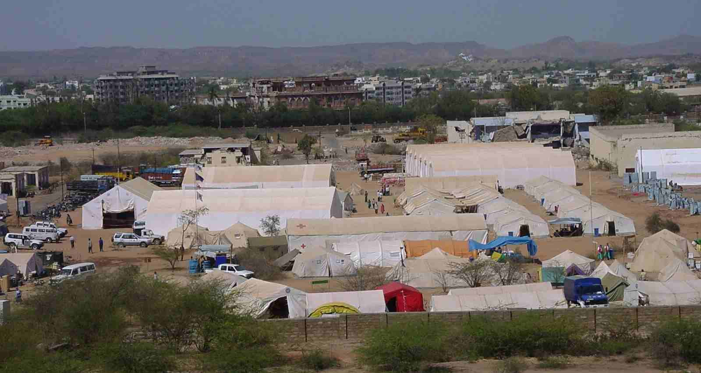
ERU
ERU Hospital (Joint Finnish RC and Norway RC, 300 beds. Bhuj earthquake)
Notes:
Site of joint Federation / NS operations in grounds of a damaged college in Bhuj.
Numerous ERUs all deployed together and living and working in same site – requires good collaboration, coordination and team spirit to make it work
Health ERUs must comply (by law) with local and WHO health standards
Statistical analysis (mortality / morbidity rates for common diseases) are compiled using Health Monitoring System – key indicators will be used in reports and for documenting trends –eg. For epidemics

Slide 11
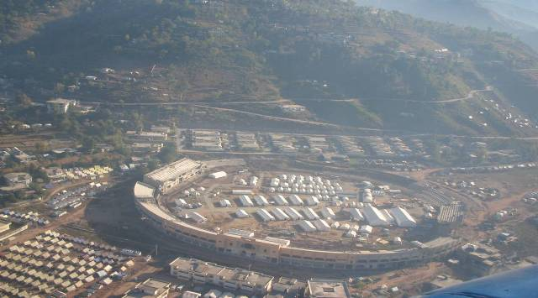
ERU
ERU Hospital (Pakistan Earthquake)
Notes:
Site of joint Federation / NS operations in grounds of a damaged college in Bhuj.
Numerous ERUs all deployed together and living and working in same site – requires good collaboration, coordination and team spirit to make it work
Health ERUs must comply (by law) with local and WHO health standards
Statistical analysis (mortality / morbidity rates for common diseases) are compiled using Health Monitoring System – key indicators will be used in reports and for documenting trends –eg. For epidemics

Slide 12
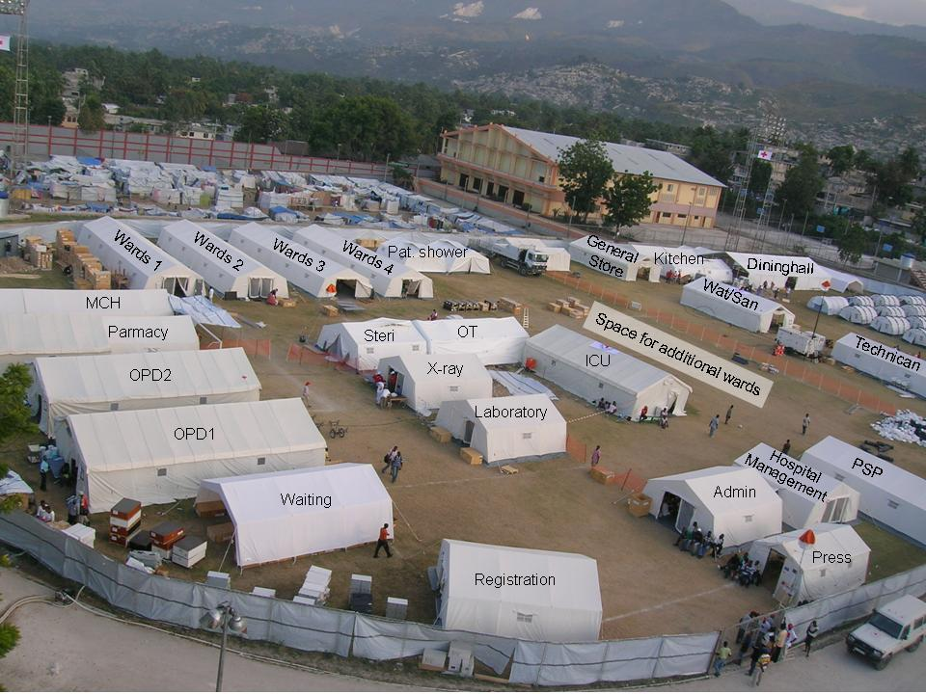
ERU
ERU Hospital (Haiti Earthquake)
Notes:
Site of joint Federation / NS operations in grounds of a damaged college in Bhuj.
Numerous ERUs all deployed together and living and working in same site – requires good collaboration, coordination and team spirit to make it work
Health ERUs must comply (by law) with local and WHO health standards
Statistical analysis (mortality / morbidity rates for common diseases) are compiled using Health Monitoring System – key indicators will be used in reports and for documenting trends –eg. For epidemics

Slide 13
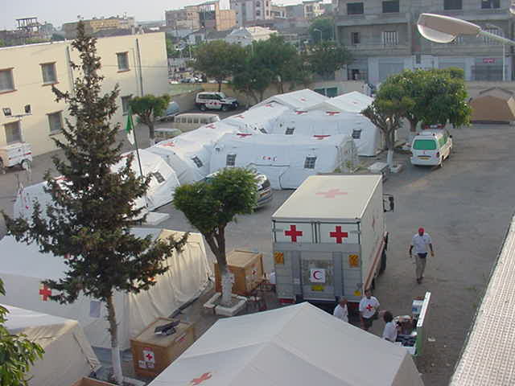
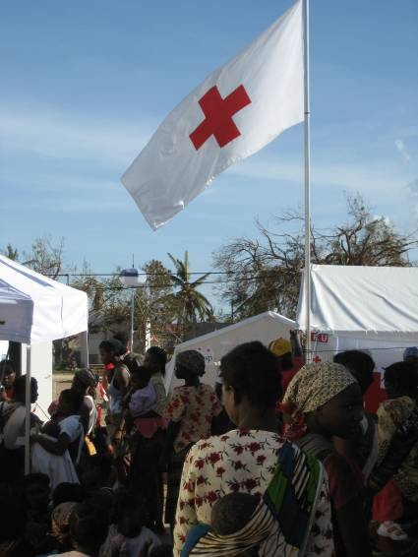
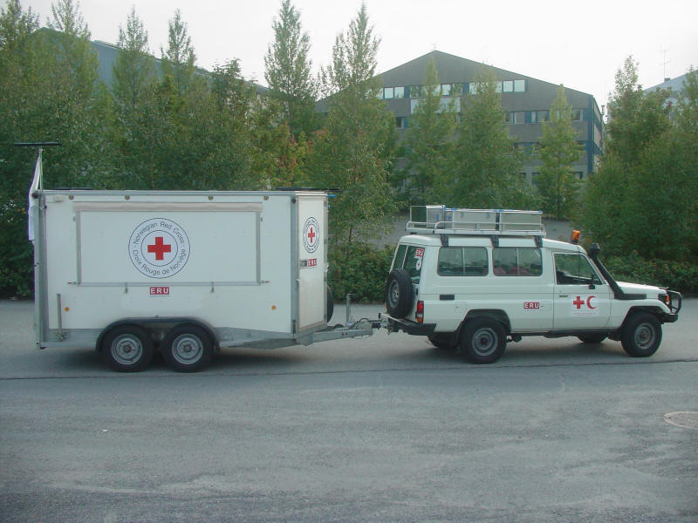
ERU Clinic
ERU Basic Health Care, Algeria 2003
Notes:
Spanish RC bhc ERU – was used to fill in a gap caused by destruction of local health clinic following earthquake. Following deployment some equipment donated to the national Society for the rehabilitation phase.

Slide 14
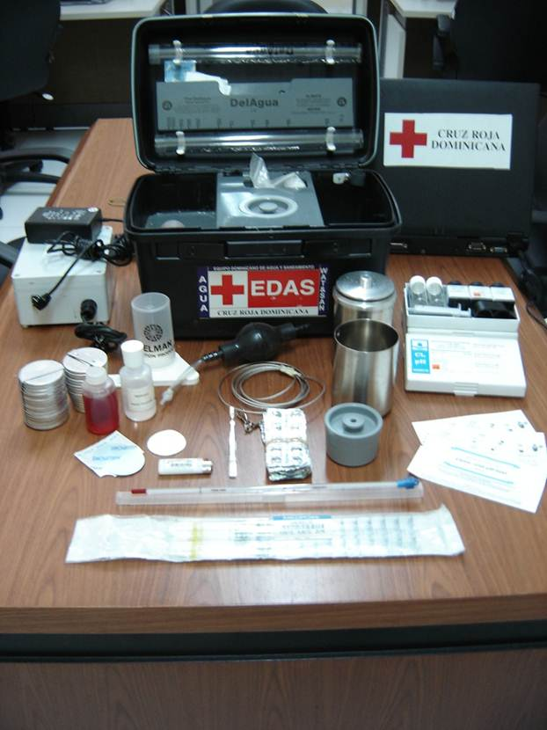
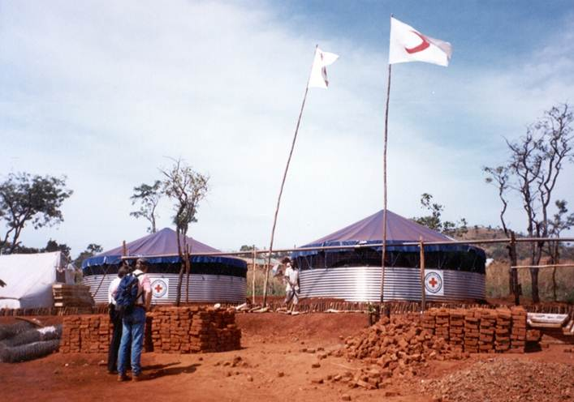
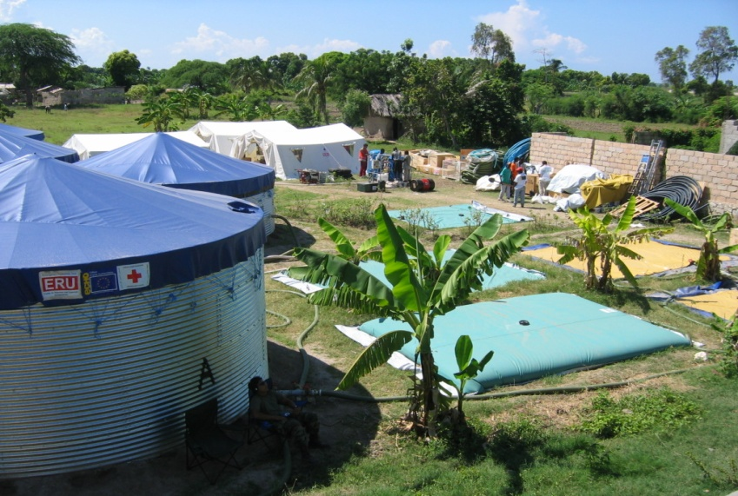
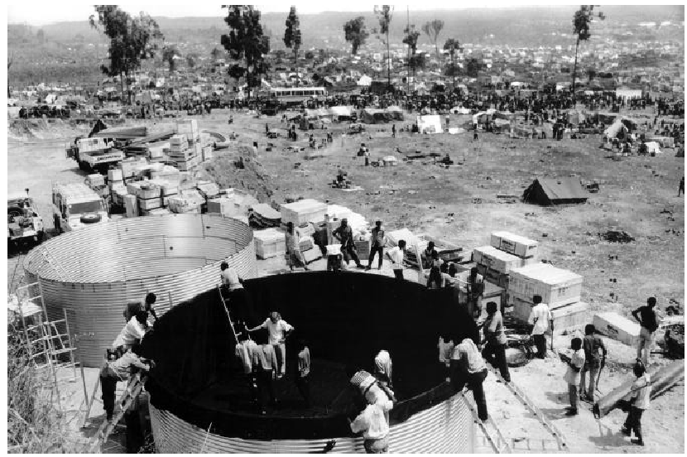
WatSan M40 ERU, Indonesia 2005
ERU
ERU WatSan M40

Slide 15
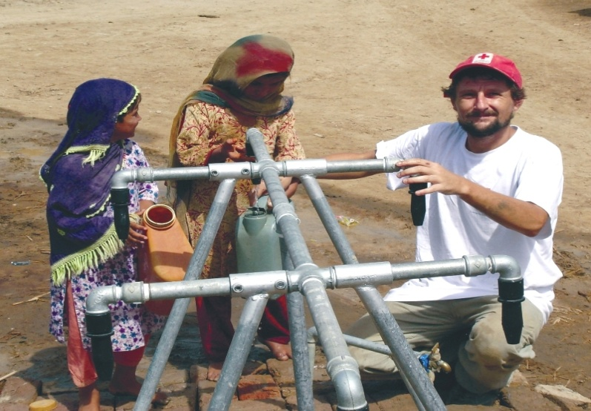
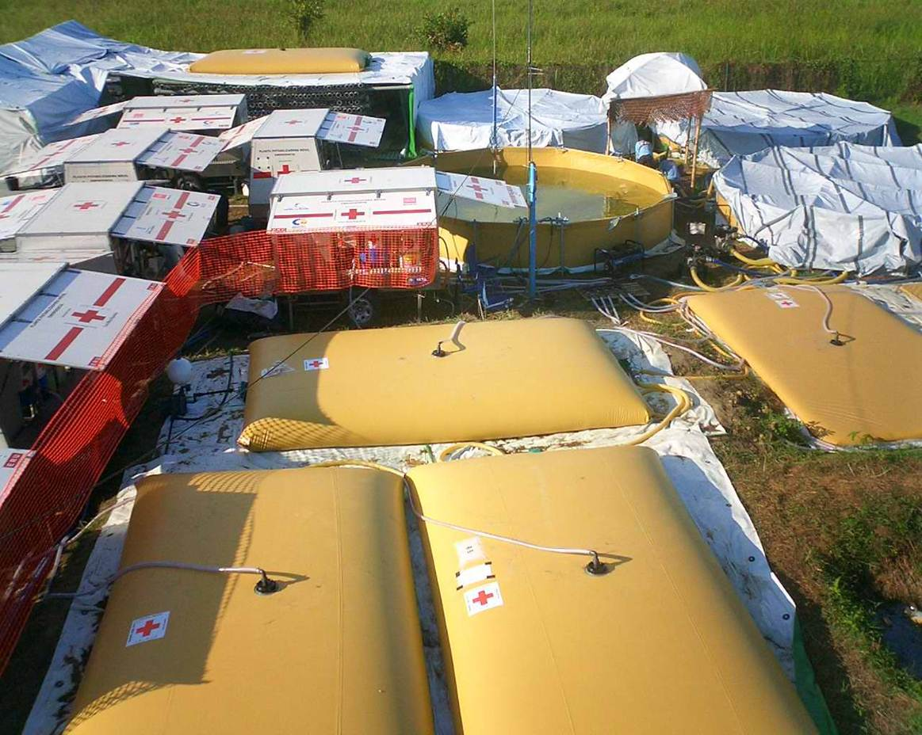
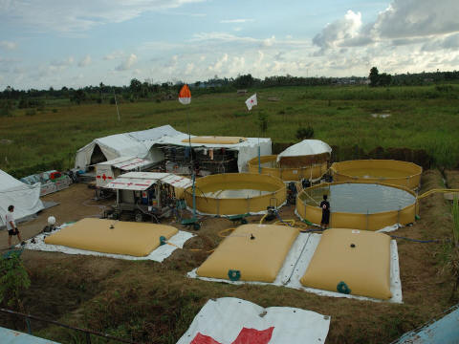
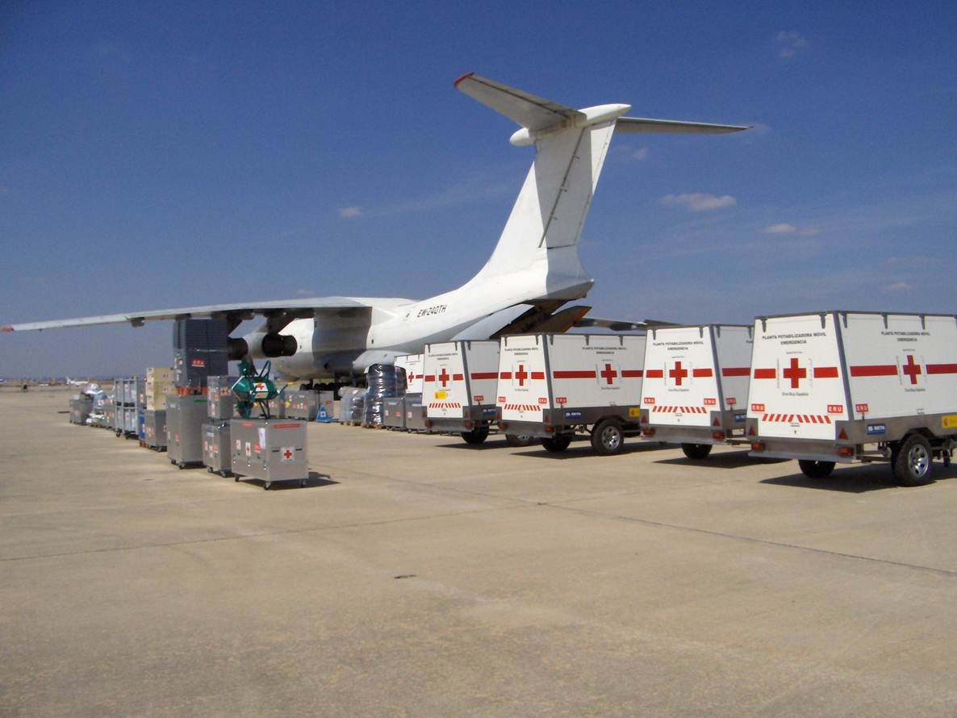
ERU WatSan M15

Slide 16
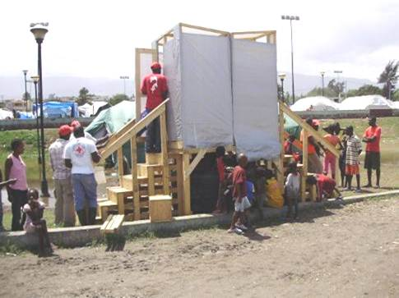
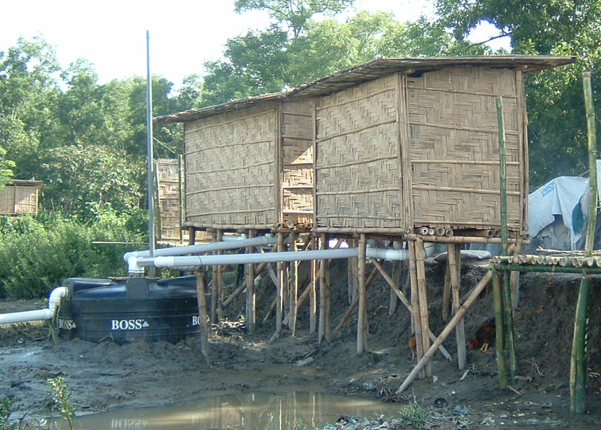
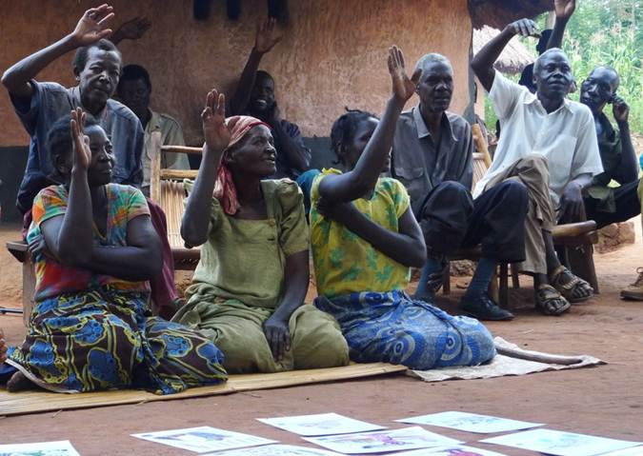
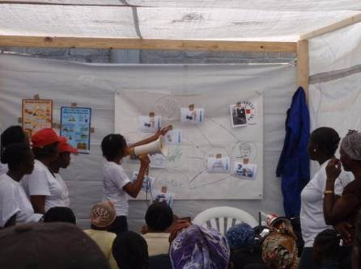
ERU WatSan MSM20

Slide 17
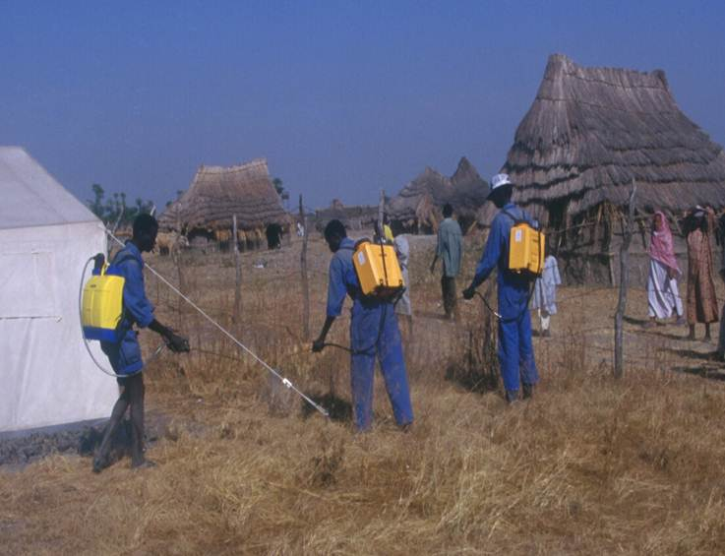
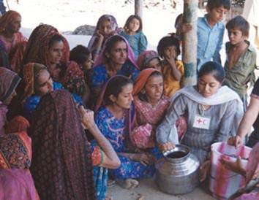
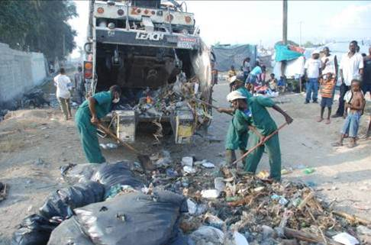
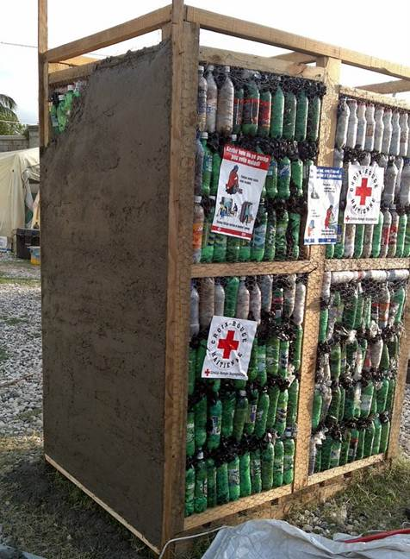
ERU WatSan MSM20

Slide 18
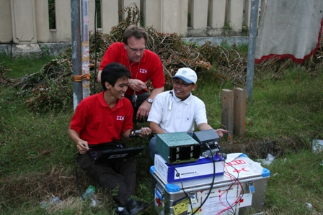
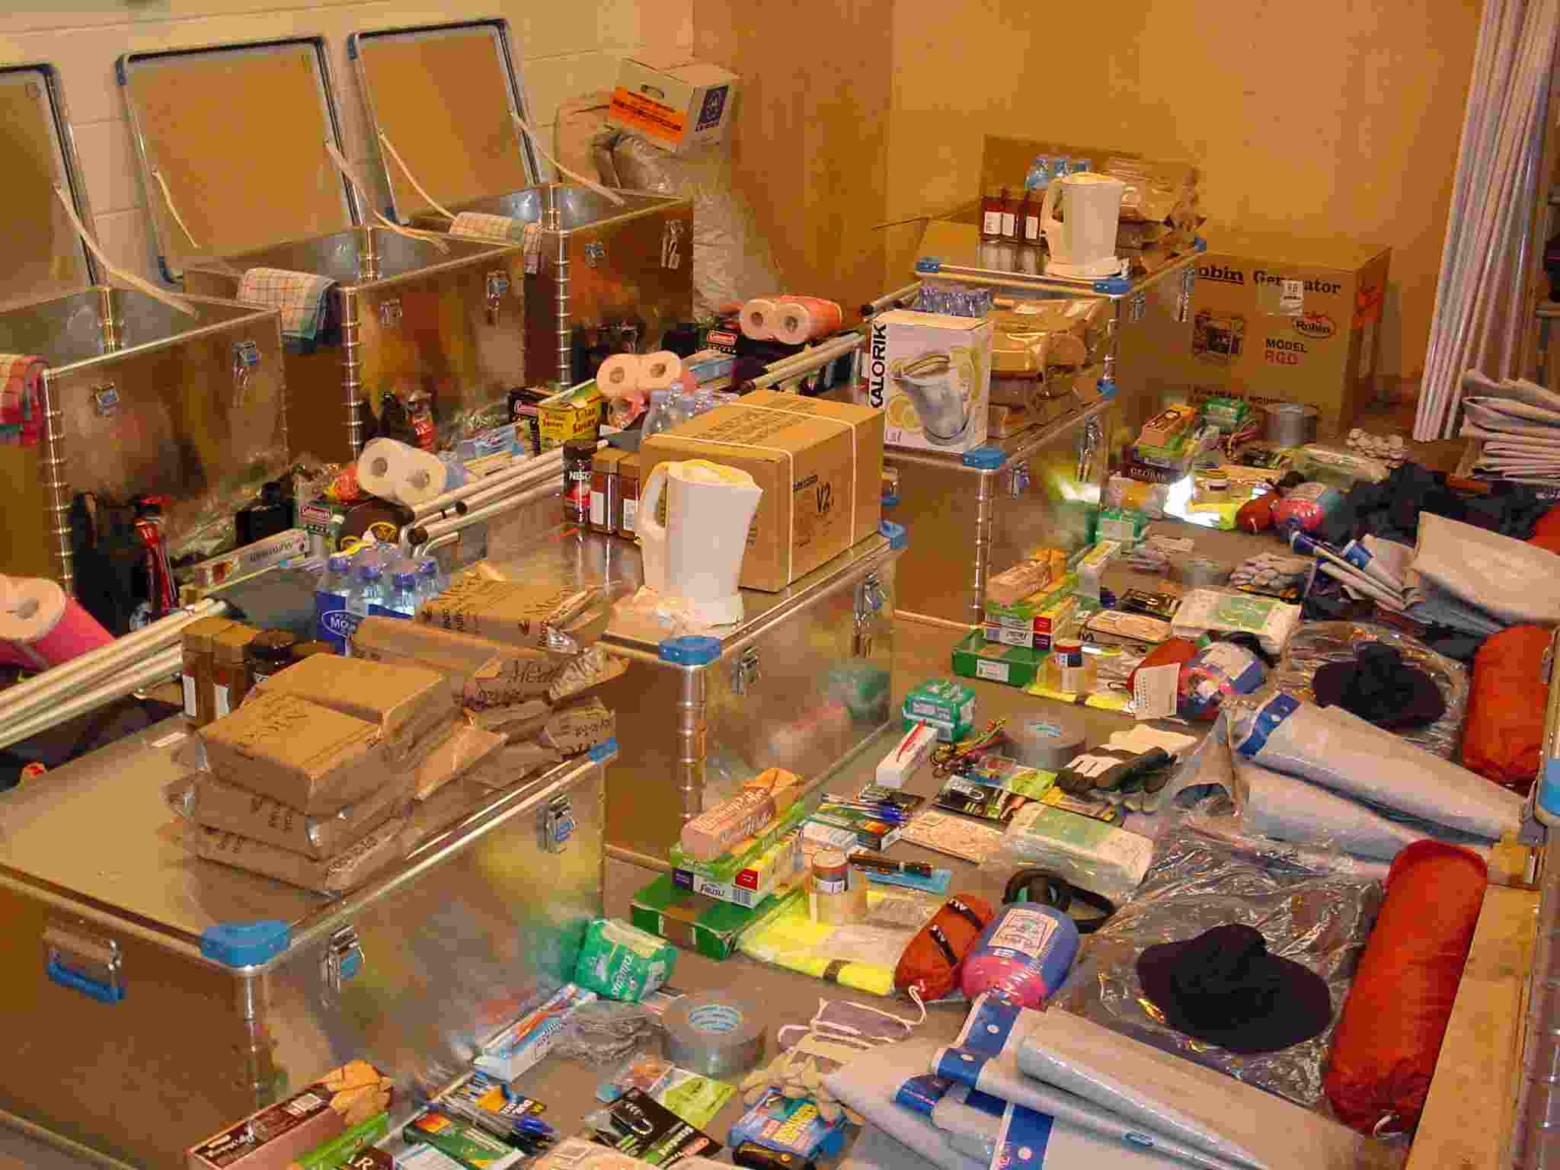
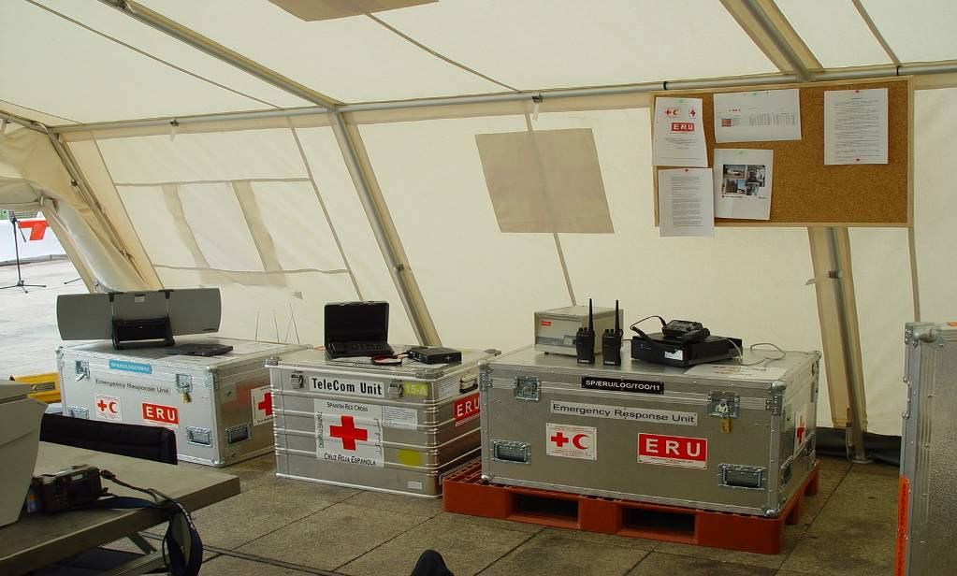
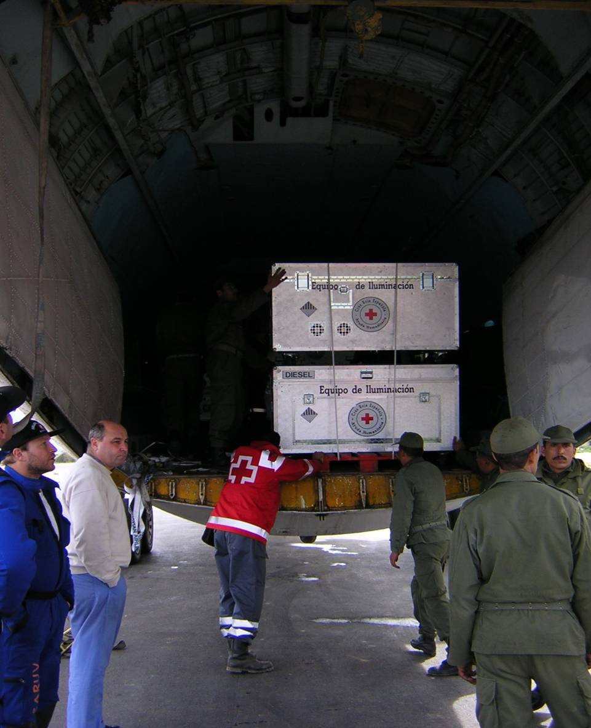
ERU Telecom
Logistics ERU

Slide 19
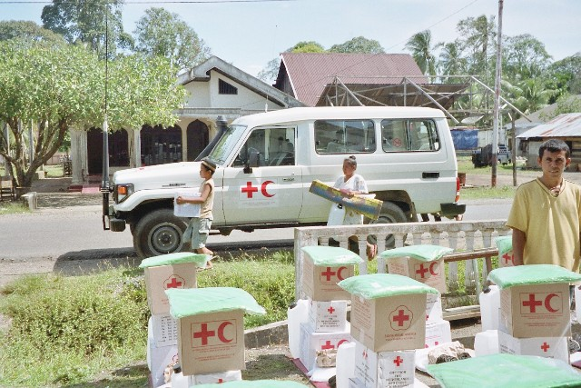
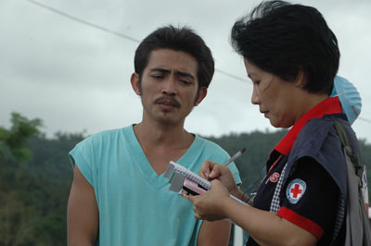
ERU
Relief ERU
NDRT and RDRTs interact frequently with the Relief ERU delegates

Slide 20
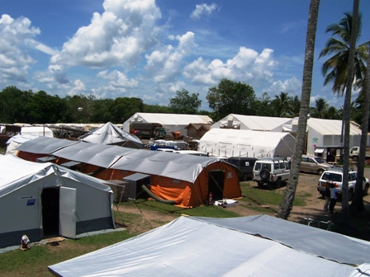
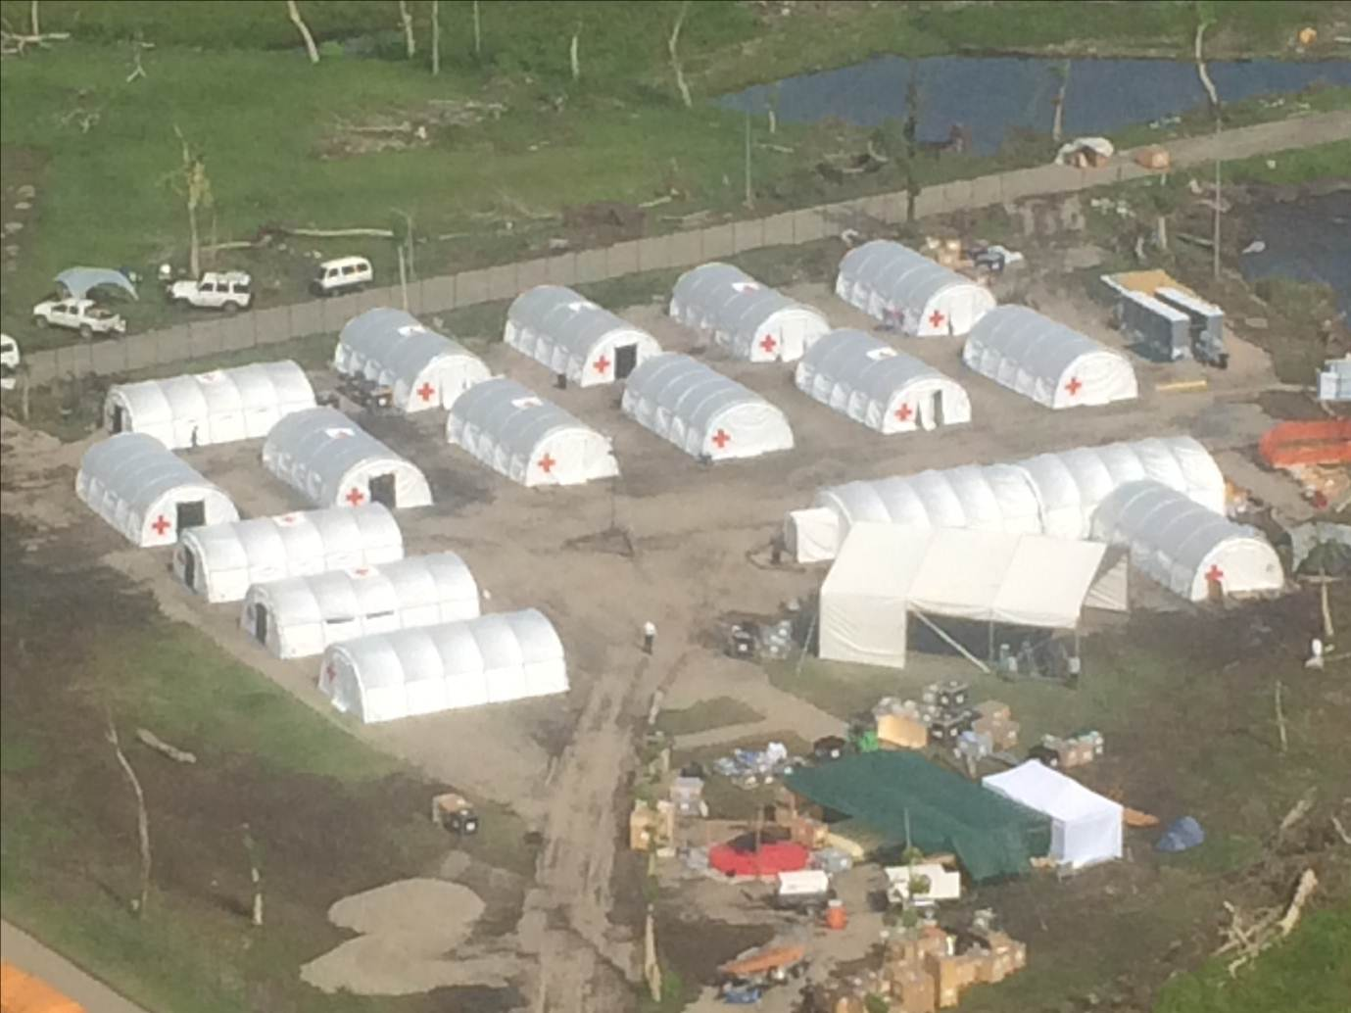
Base camp ERU
Philippines 2013
Indonesia 2005

Slide 21

        VIDEO
        Head of Emergency Operations

Slide 22

Questions? Comments?
THANKS

