Slide 1
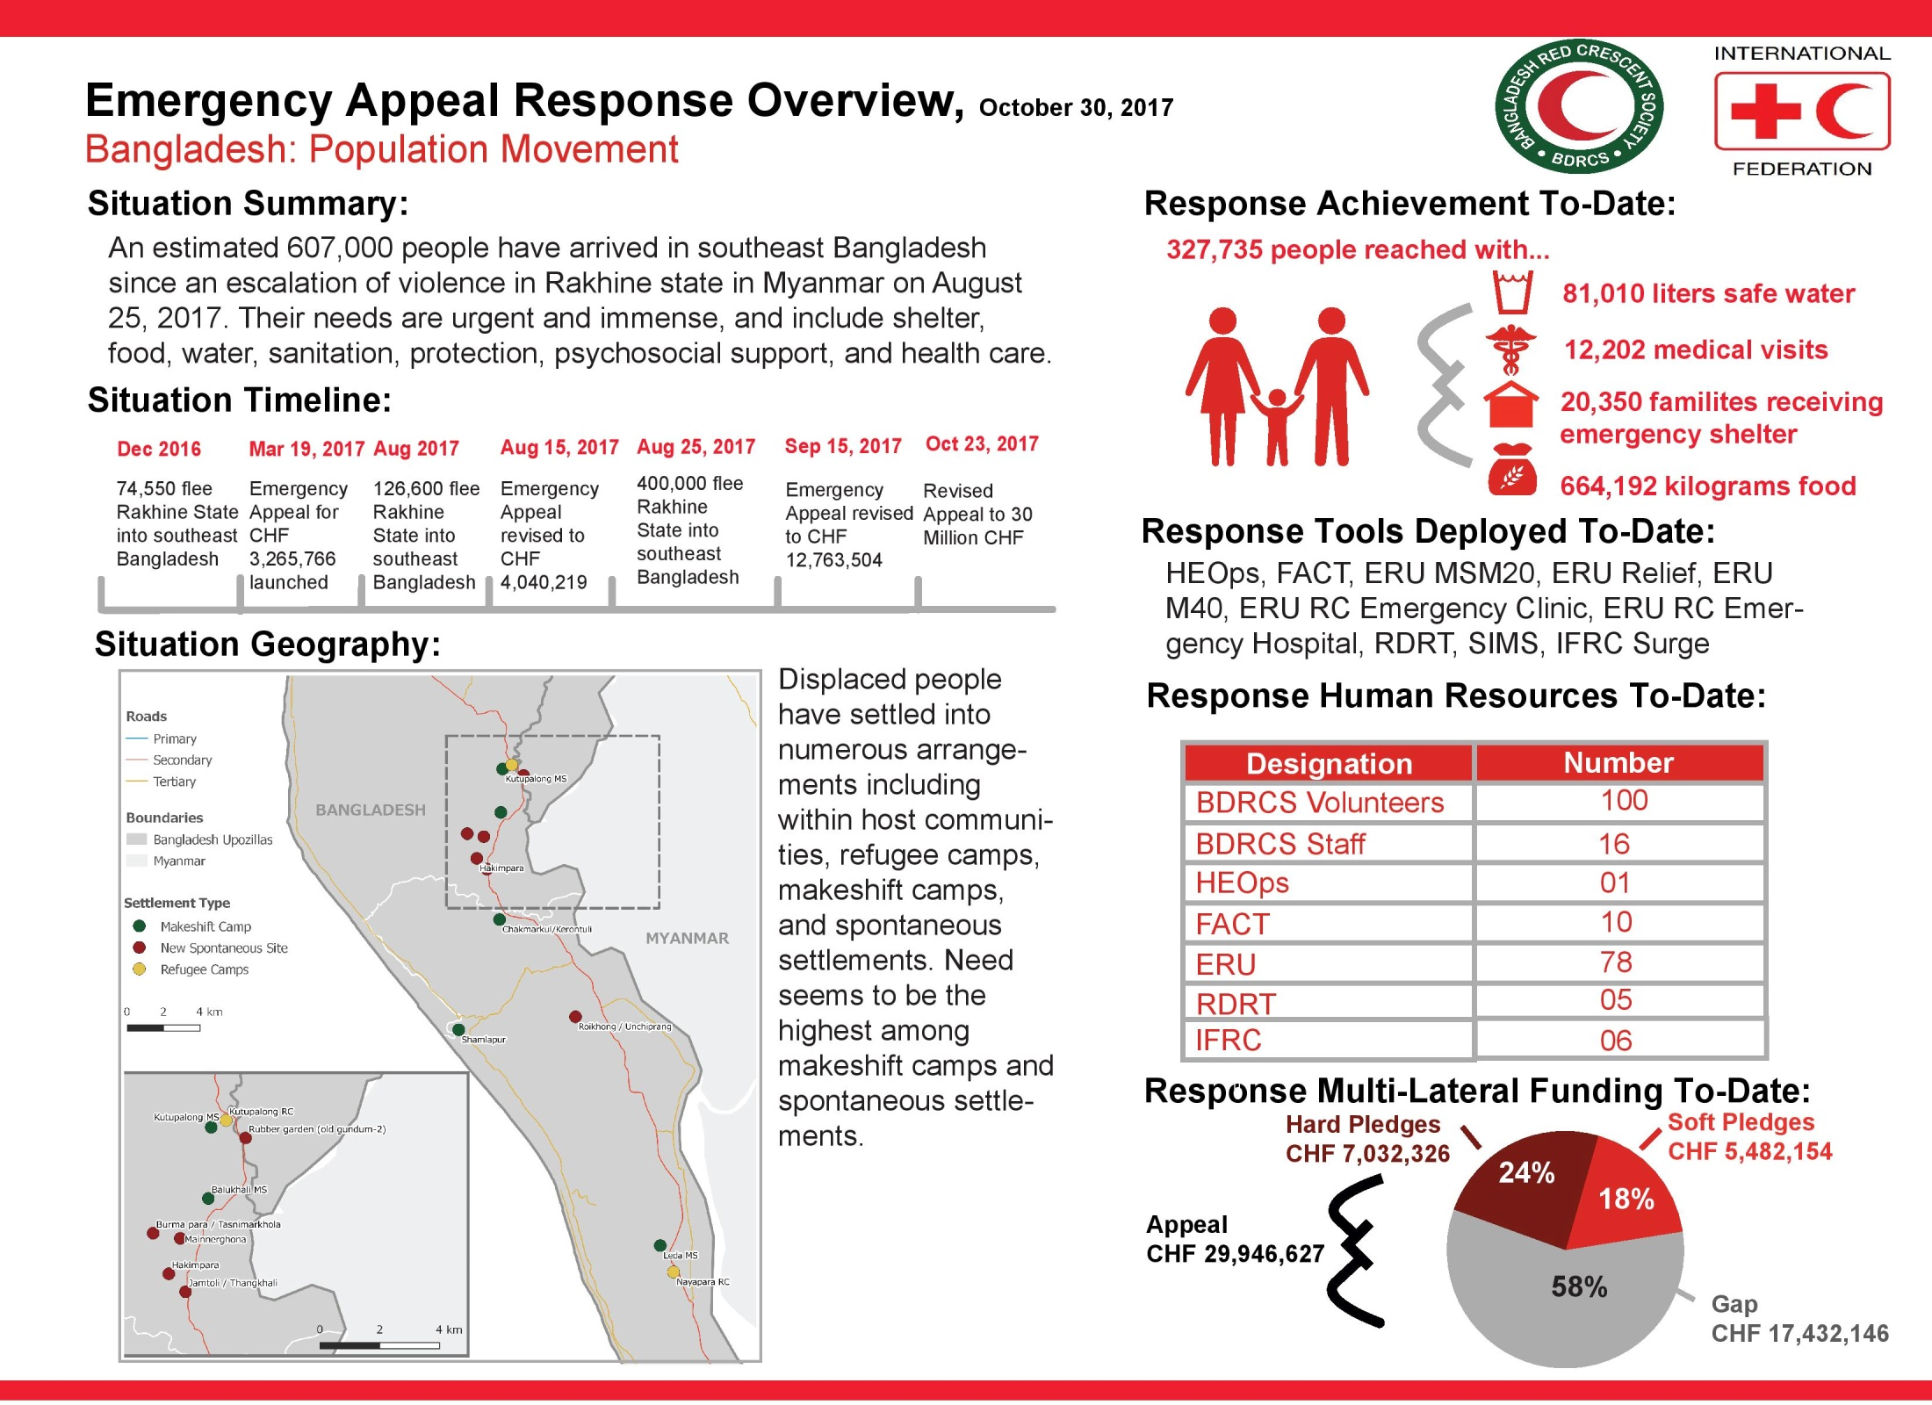
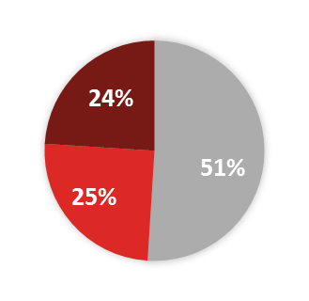
6 November 2017
102,710 liters safe water
15,532 medical visits
21,350 families receiving emergency shelter
22,749 families receiving emergency shelter
765,073 kilograms food
07
55
Soft Pledges
CHF 7,486,657
Gap
CHF 15,272,780

